Slide 1
LED Matrix Final Presentation
By:Kenny, Nick, Devon, Abe, Harrison

Slide 2
Overview
Project Organization
Finalized System
Architectural/Context Model
System Requirements
Characters and Symbols
Display Animations
Cost
Conclusion

Slide 3
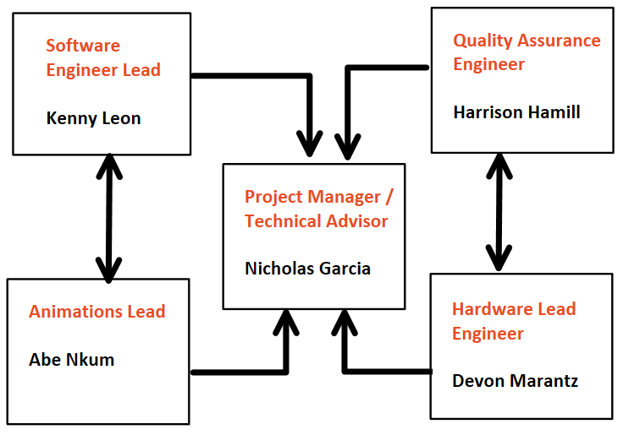
Project Organization

Slide 4
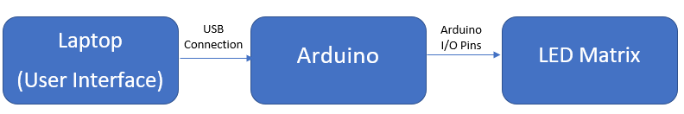
Finalized System
Refined System Overview

Slide 5
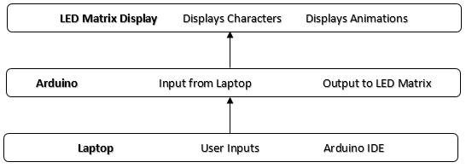
Architectural Model
LED Matrix - Displays the user selected characters/animations.
Arduino - Responsible for taking user inputs via USB from laptop. Outputs corresponding visual on LED Matrix.
Laptop - Uses Arduino IDE to take in user defined animations and output to arduino.

Slide 6
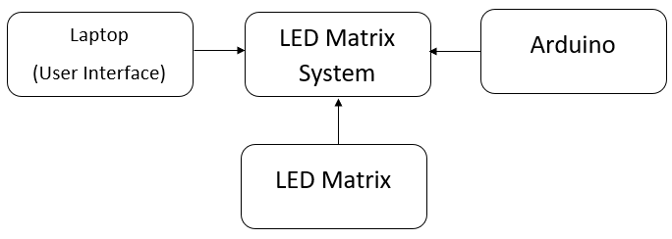
Top Level Context Model
Laptop - This is the main link between the user and the System. Uses Arduino IDE to communicate with the Arduino and thus the LED Matrix
Arduino - Receives commands from the laptop and transmits to the LED matrix via I/O pins
LED Matrix - 8x15 LED matrix array. Displays Characters/Symbols and Animations.

Slide 7
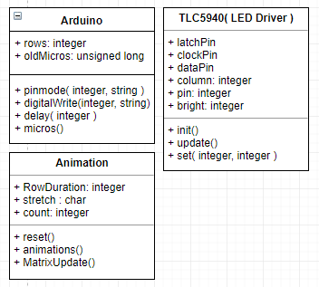
Code Diagram

Slide 8
System Requirements
Functional: Non--Functional
The LED Matrix shall… The LED Matrix shall...
1. Display animations, letters & pictures 1. Be portable.
to the user
2. Have bright LEDs for clear visualization 2. Run off of 9V
3. 3. Last for 16 minutes per new 9V

Slide 9
Animations\Characters and Symbols

Slide 10
Cost
Item | Quantity | Price
TLC5940NT | 1 | 7.95
Angled Aluminum | 2 | 7.94
Acrylic Light Lens | 1 | 12.98
Breadboard 630 Tie Pts | 2 | 11.98
9V Battery | 1 | 3.39
PMOS | 8 | 8.00
Arduino UNO | 1 | 29.95
Red LED 100pc | 2 | 13.14
Tax | 1 | 7.63
Total = $102.96

Slide 11
Conclusion
The System can output user defined characters and animations via USB.
Potential additional features in the future:
WiFi capabilities.
Real Time displays rather than user defined outputs.

